Slide 1
CAPSTONE PROJECT
Algorithms
Employee Salary Prediction Using Machine
Presented by:
Asna Faizeen – saanvi women’s degree college - computer Applications Aicte internship program

Slide 2
OUTLINE
Problem Statement
System Development Approach
Algorithm & Deployment
Result
Conclusion
Future Scope
References

Slide 3
Problem Statement
The project addresses the real-world challenge of predicting employee salaries based on various factors such as education, experience, and job role. With the growing demand for accurate salary benchmarks, companies need efficient models that can assist in resource planning and hiring decisions. The unstructured and inconsistent data from various industries makes manual analysis time-consuming. Traditional methods fail to account for non-linear relationships and patterns. Hence, an intelligent solution is required to enhance decision-making in HR and payroll systems.

Slide 4
System Development Approach
The System was developed using a machine learning-based approach in python. Data preprocessing involved cleaning and encoding categorical variables, followed by applying suitable models.
Libraries used:
1.Pandas
2. Numpy
3. Scikit-learn
4. Imbalanced-learn
5. Streamlit

Slide 5
System Requirements:
Python 3.10+
Google Colab
Web browser

Slide 6
Algorithm & Deployment
Step-by-Step Procedure: 1. Import the dataset and explore it using pandas. 2. Perform data cleaning (remove nulls, encode categories). 3. Split the data into training and testing sets. 4. Train the model using Random Forest Classifier. 5. Apply Linear Regression for predicting salary values. 6. Evaluate the model using accuracy score and classification report. 7. Save the model using joblib.

Slide 7
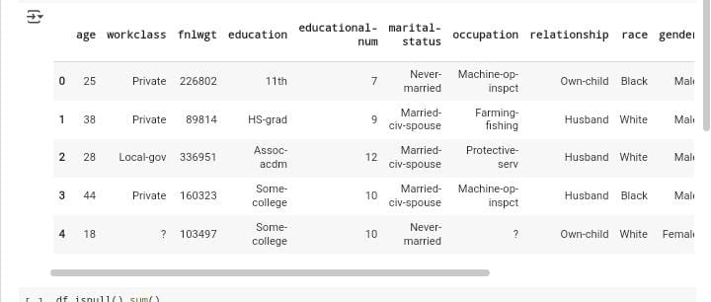
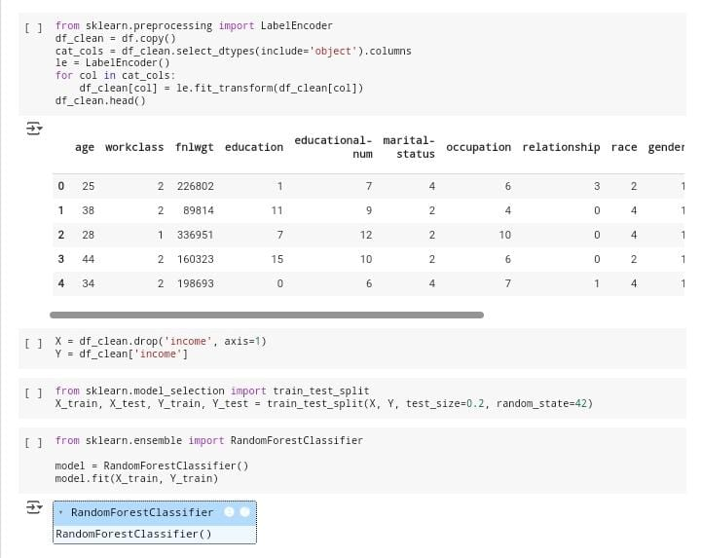
Result

Slide 8
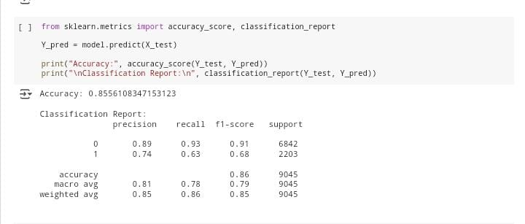
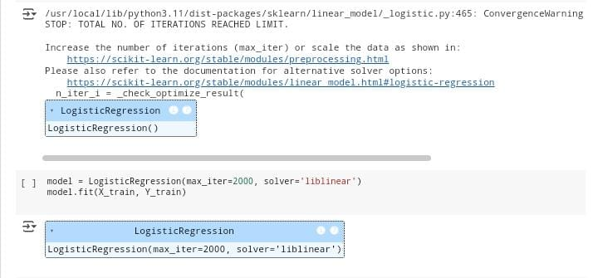

Slide 9
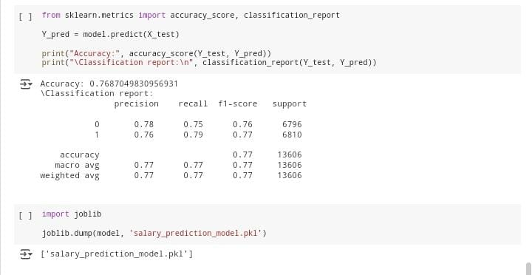
GitHub Responsitory Link: https://github.com/asnafaizeen11/Employee-Salary-Prediction.git

Slide 10
Conclusion
This project successfully demonstrates how machine learning can be used to predict employee salaries with considerable accuracy. The Random Forest and Linear Regression models provided insights into salary trends based on various attributes. Challenges included handling categorical variables, optimizing model accuracy, and deploying the solution. Future improvements may include using deep learning techniques or integrating with HR management software.

Slide 11
Future Scope
Add a frontend interface for recruiters to interact with the system.
Train with larger real-time datasets from LinkedIn or Kaggle. Integrate with APIs for live data fetching and prediction. Include more features such as company size, location, or job market trends.

Slide 12
References
IBM skillBuild – AI/ML Course Material
Adult Salary Dataset – Source: Provide by mentor
Employee Salary Prediction – https://colab.research.google.com/drive/1JB_RelHj8es7l7m8tHE5hQivwxxreYbi?usp=sharing
Python Libraries and Tools – pandas, numpy, scikit-learn, imbalanced-learn .

Slide 13
Thank you

